Slide 1
Securing REST Services with Spring Boot

Slide 2
Objectives
Session-based security
HTTP Basic authentication
Digest authentication
Certificate-based security
XAuth
Oauth
JWT Implementation in Spring REST

Slide 3
Introduction
RESTful web services
Architectural style for distributed systems
Relies on HTTP methods (GET, POST, PUT, DELETE)
Stateless communication
Why security is crucial?
Protect sensitive data
Prevent unauthorized access
Ensure integrity and confidentiality

Slide 4
Session-Based Security (1)
User authenticates, server creates a session
Session ID stored in a cookie on the client
Subsequent requests include the session ID for validation
Pros:
Simple to implement
Well-suited for traditional web applications
Cons:
Scalability challenges (session storage)
Not ideal for mobile or distributed environments
Vulnerable to CSRF attacks

Slide 5
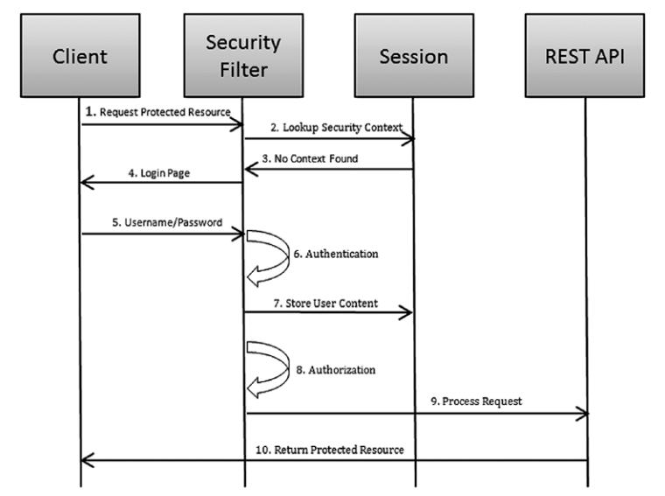
Session-Based Security (2)
Session-based security flow
Notes:
Chapter 8 - Spring REST Building Java Microservices and Cloud Applications (Balaji Varanasi, Maxim Bartkov)

Slide 6
HTTP Basic Authentication (1)
Client sends credentials (username/password) encoded in the Authorization header
Server decodes and verifies credentials
Pros:
Simple and widely supported
Easy to implement in Spring Boot
Cons:
Credentials transmitted in plain text (use HTTPS!)
Limited security features

Slide 7
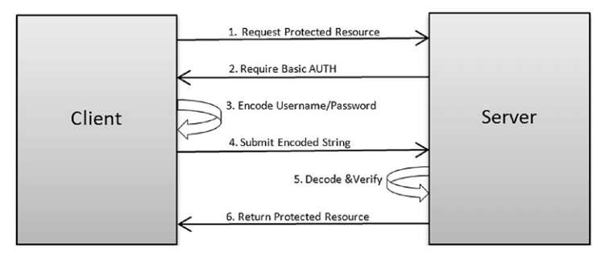
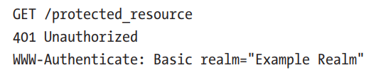

HTTP Basic Authentication (2)
HTTP Basic authentication flow
Notes:
Chapter 8 - Spring REST Building Java Microservices and Cloud Applications (Balaji Varanasi, Maxim Bartkov)

Slide 8
Digest Authentication (1)
More secure than Basic Authentication
Uses a nonce (one-time value) to prevent replay attacks
Credentials are not sent in plain text
Pros:
Enhanced security compared to Basic Authentication
Cons:
More complex to implement
Not supported by all clients

Slide 9
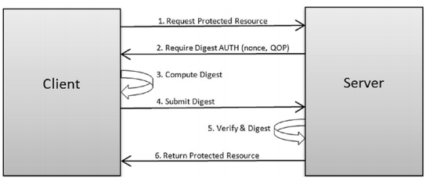
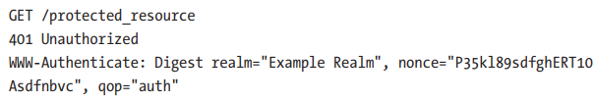


Digest Authentication (2)
Digest authentication flow
Notes:
Chapter 8 - Spring REST Building Java Microservices and Cloud Applications (Balaji Varanasi, Maxim Bartkov)

Slide 10
Certificate-Based Security (1)
Client and server use digital certificates for authentication
Certificates are issued by trusted authorities
Pros:
Strong security
Mutual authentication (client and server verify each other)
Cons:
Complex setup and management of certificates

Slide 11
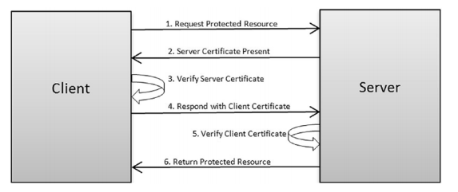
Certificate-Based Security (2)
Notes:
Chapter 8 - Spring REST Building Java Microservices and Cloud Applications (Balaji Varanasi, Maxim Bartkov)

Slide 12
XAuth (1)
A custom authentication mechanism
Often involves exchanging a shared secret key
Pros:
Flexibility in design
Can be tailored to specific needs
Cons:
Requires careful implementation to ensure security
Not a standard approach

Slide 13
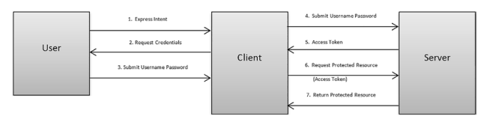
XAuth (2)
XAuth security flow
Notes:
Chapter 8 - Spring REST Building Java Microservices and Cloud Applications (Balaji Varanasi, Maxim Bartkov)

Slide 14
OAuth 2.0 (1)
Delegated authorization framework
Allows users to grant third-party applications access to their resources without sharing credentials
Uses tokens for authorization
Pros:
Industry standard
Enhanced security and user control
Well-suited for modern web and mobile applications
Cons:
More complex to implement than basic methods

Slide 15
OAuth 2.0 (2)
OAuth 2.0 defines the following four roles:
Resource owner - A resource owner is the user that wants to give access to portions of their account or resources.
Client - A client is an application that wants access to a user’s resources. This could be a third-party app wants to access a resource.
Authorization server - An authorization server verifies the user’s identity and grants the client a token to access the user’s resources.
Resource server—A resource server hosts protected user resources.

Slide 16
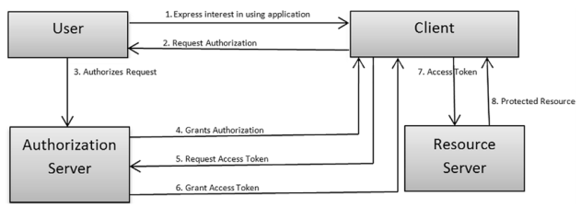

OAuth 2.0 (3)
OAuth 2.0 security flow
Notes:
Chapter 8 - Spring REST Building Java Microservices and Cloud Applications (Balaji Varanasi, Maxim Bartkov)

Slide 17
Spring Boot Security
Spring security framework
Robust and highly customizable
Provides comprehensive security features
Seamless integration with Spring Boot
Characteristics
Authentication providers
Authorization mechanisms
Protection against common attacks (CSRF, session fixation)

Slide 18
Defining Terminology
Authentication refers to the process of verifying the identity of a user, based on provided credentials. An example is entering a username and a password when you log in to a website. The answer to the question Who are you?.
Authorization refers to the process of determining if a user has proper permission to perform a particular action or read particular data, assuming that the user is successfully authenticated. The answer to the question Can a user do/read this?.
Principle refers to the currently authenticated user.
Granted authority refers to the permission of the authenticated user.
Role refers to a group of permissions of the authenticated user.

Slide 19
What are JSON Web Tokens (JWT)?
Open standard (RFC 7519)
Compact, self-contained way to securely transmit information between parties as a JSON object.
Digitally signed to ensure integrity.
Structure of JWT (3 parts of a JWT)
Header: Contains token type and hashing algorithm (e.g., {"alg": "HS256", "typ": "JWT"})
Payload: Contains the claims (user information, roles, expiration, etc.)
Signature: Ensures the token hasn't been tampered with.

Slide 20
Advantages of JWT
Statelessness - No need to store session information on the server.
Scalability - Easily scale horizontally as tokens are self-contained.
Mobile-friendly - Well-suited for mobile applications.
Decoupled Authentication - Can be used with various authentication methods.
Performance - Reduces database queries for authentication.

Slide 21
Disadvantages of JWT
Security concerns:
Requires careful handling of the secret key.
Vulnerable if not implemented correctly.
Token size: Can be larger than traditional session IDs.
Revocation: Difficult to revoke tokens before they expire.

Slide 22
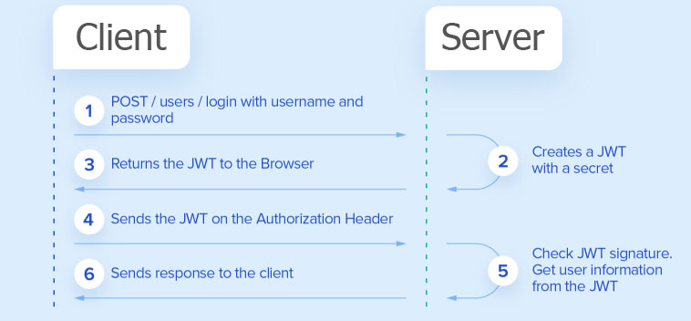
Demo JWT Implementation in Spring REST

Slide 23
Demo JWT Implementation in Spring REST
Step 1. Create Project and add dependencies
Step 2. Create a JWT utility class
Step 3. Configure Spring Security
Step 4. Create an authentication controller
Step 5. Secure endpoints
Step 6. Test the implementation

Slide 24
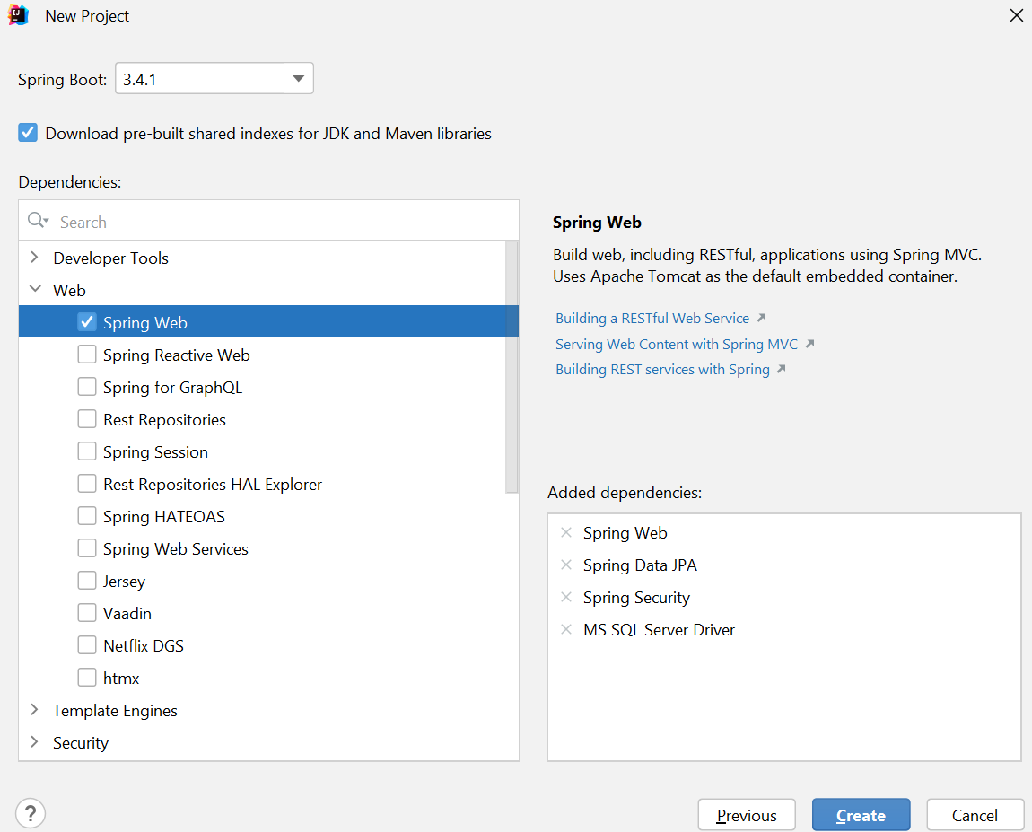
Demo JWT Implementation in Spring REST
Step 1. Create Project and add dependencies
Spring Web
Spring Security
Spring Data JPA
MS SQL Driver

Slide 25
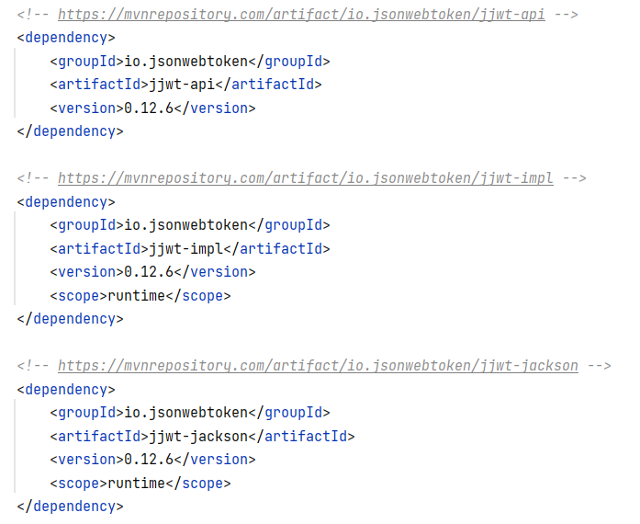
Step 1. Create Project and add dependencies
Add JSON Web Token dependencies

Slide 26
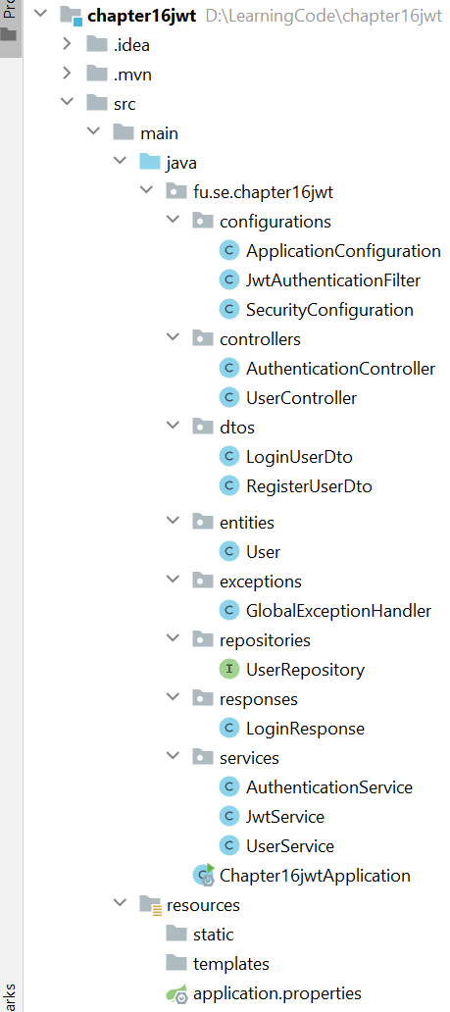
Step 1. (contd.)
Project structure
configurations
controllers
dtos
entities
exceptions
repositories
response
services

Slide 27
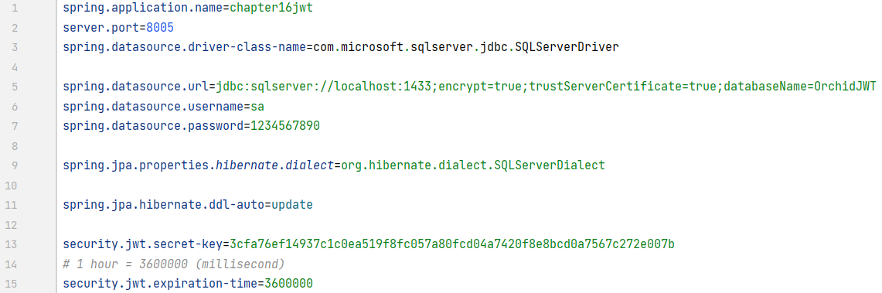
Step 1. (contd.)
Application.properties

Slide 28
Step 1. (contd.)
Create the user entity. Then, extend the User Entity with authentication details.
To manage user details related to authentication, Spring Security provides an interface named “UserDetails” with properties and methods that the User entity must override the implementation.
The method “getAuthorities()” returns the user’s roles list; it is helpful to manage permissions.
The method “getUsername()” returns the email address because it is unique information about the user.

Slide 29
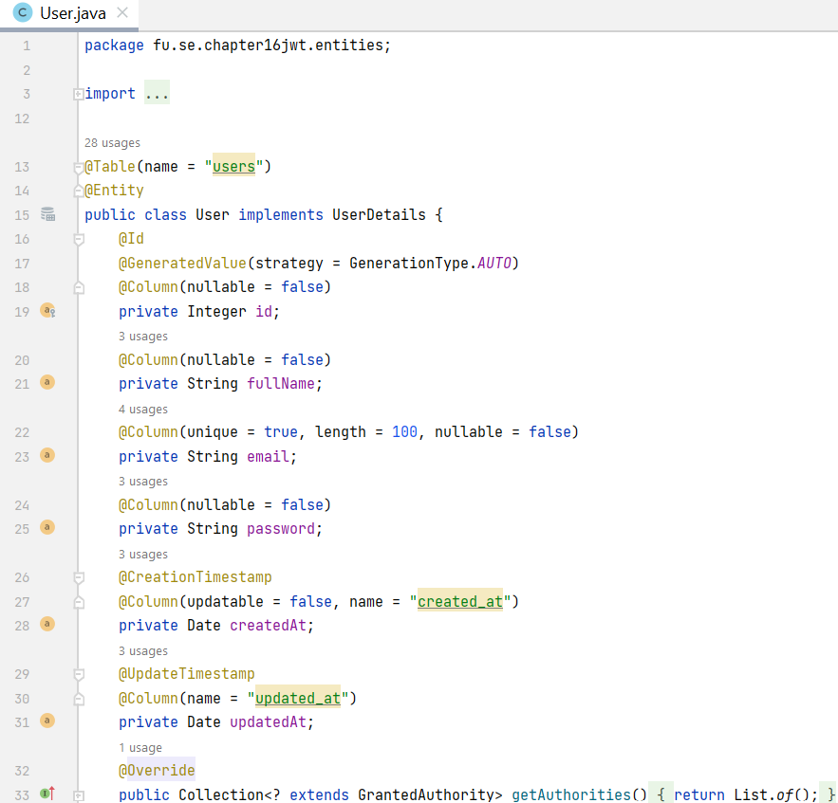
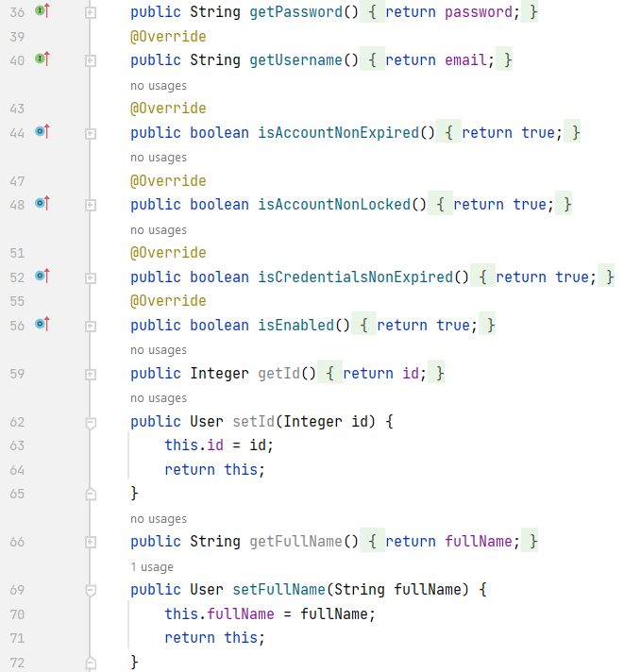
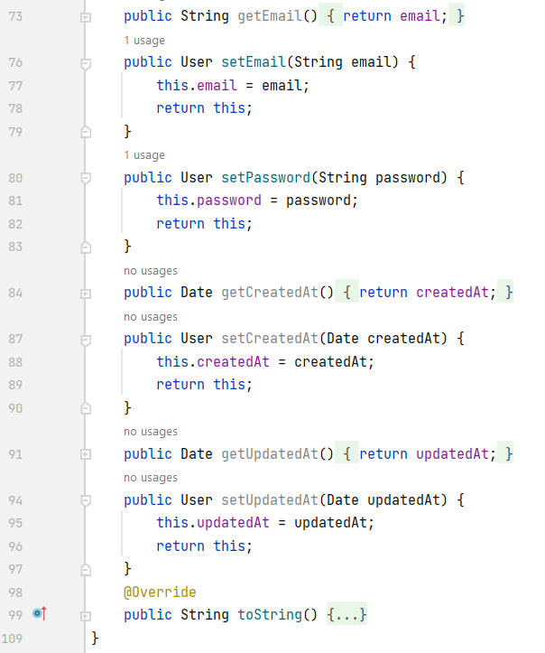
Step 1. (contd.) User entity

Slide 30
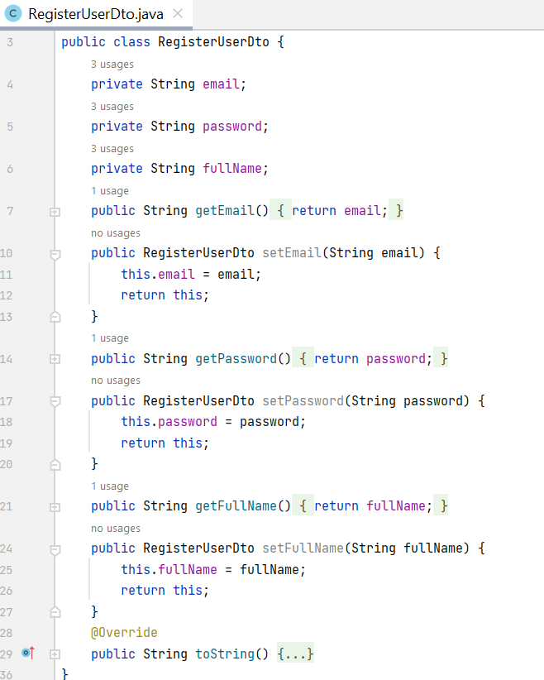
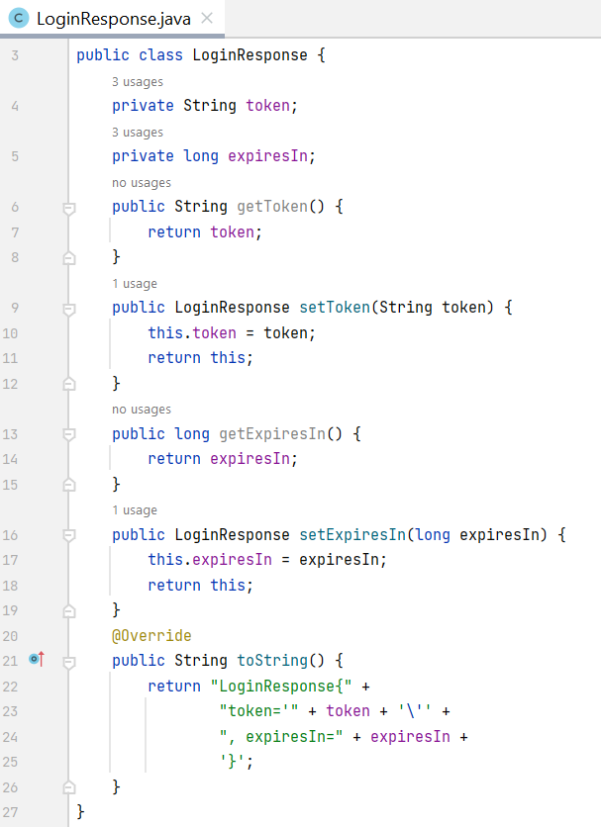
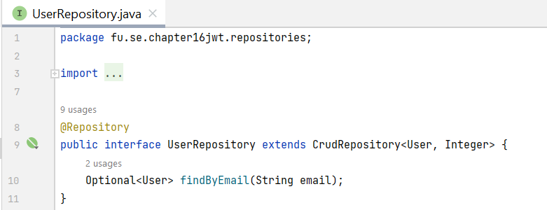
Step 1. (contd.)

Slide 31
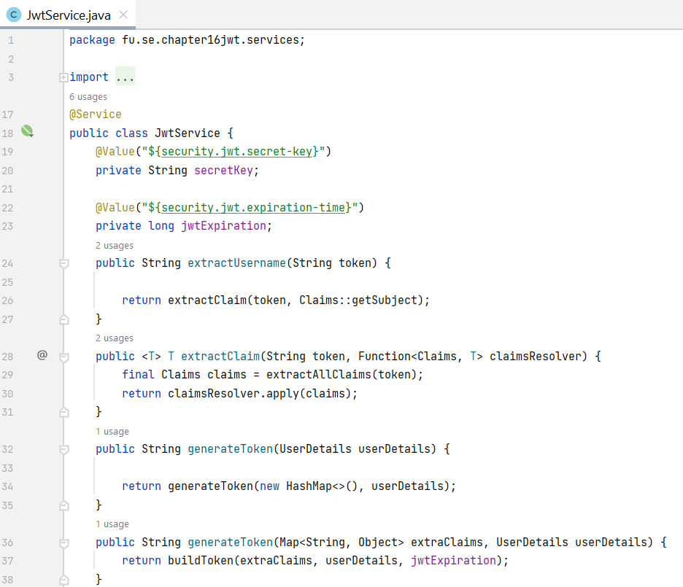
Step 2. Create related JWT classes
Generate JWTs: Use io.jsonwebtoken.Jwts to create tokens with claims, expiration, and signing.
Validate JWTs: Verify signature and extract claims.

Slide 32
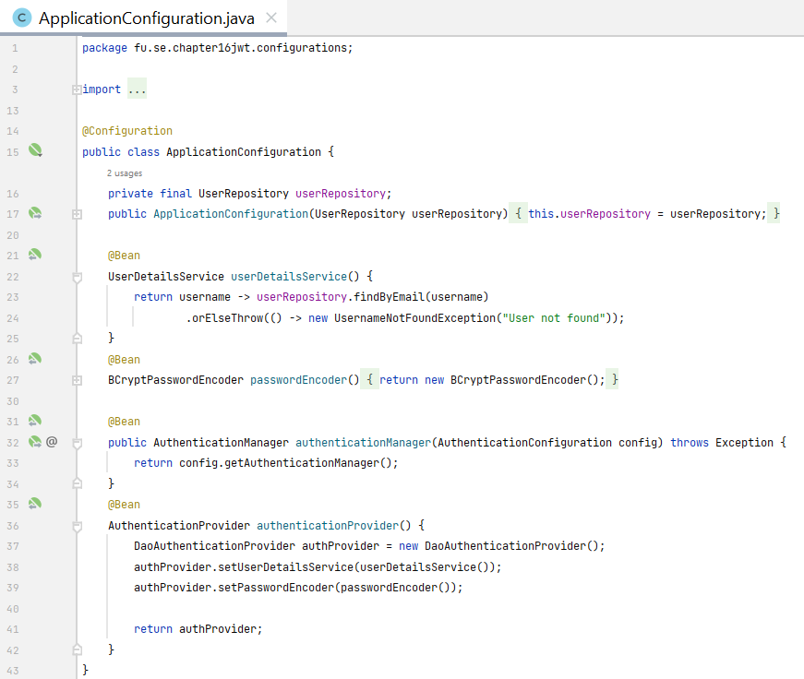
Step 2. (contd.)
Override the security configuration
userDetailsService() defines how to retrieve the user using the UserRepository that is injected.
passwordEncoder() uses to encode the plain user password.
authenticationProvider() sets the new strategy to perform the authentication.

Slide 33
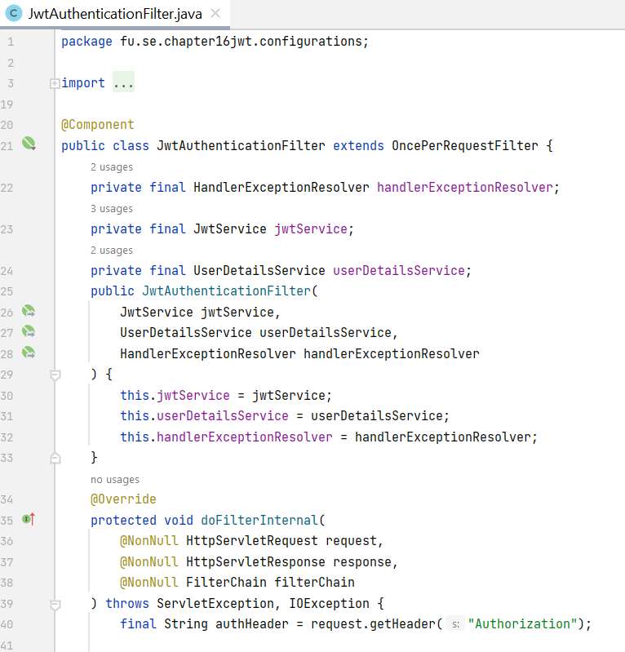
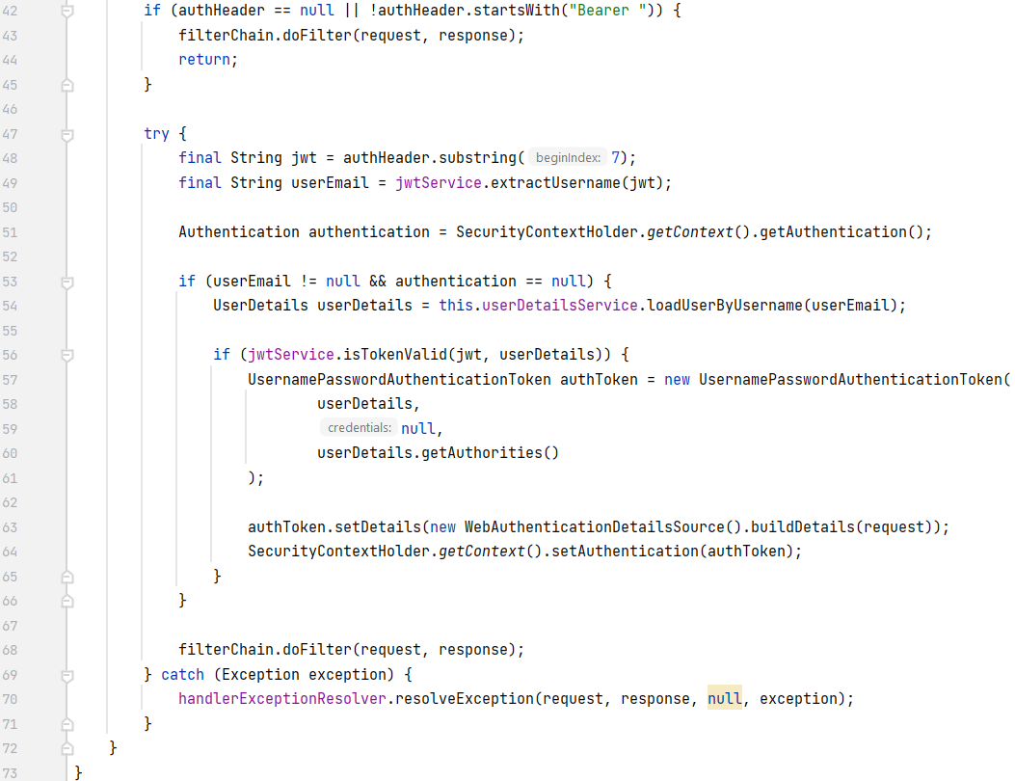
Step 3. Configure Spring Security

Slide 34
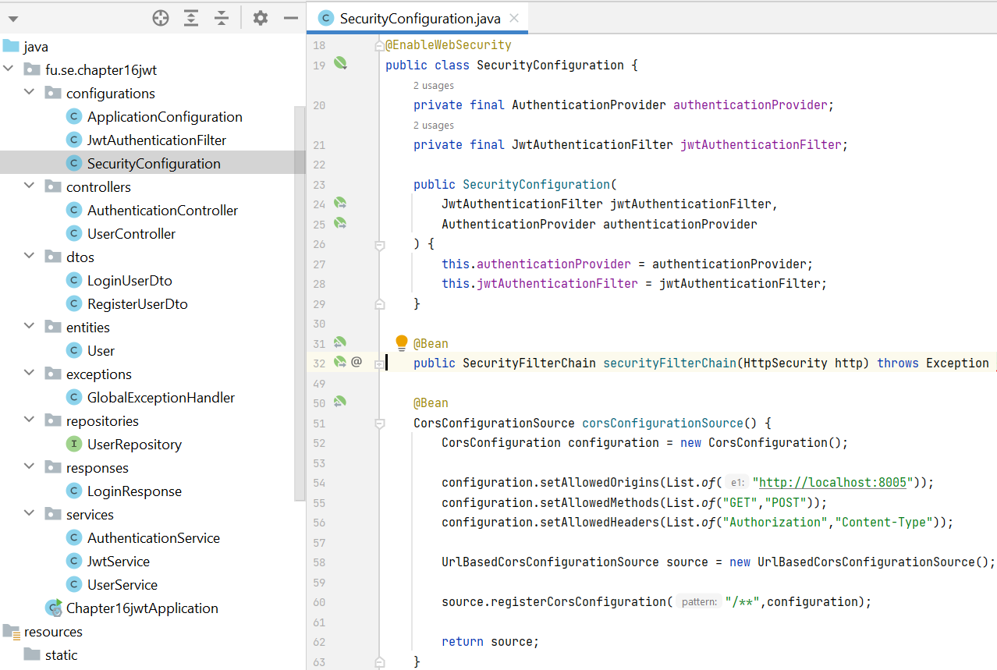
Step 3. (contd.) Configure the requester filter

Slide 35
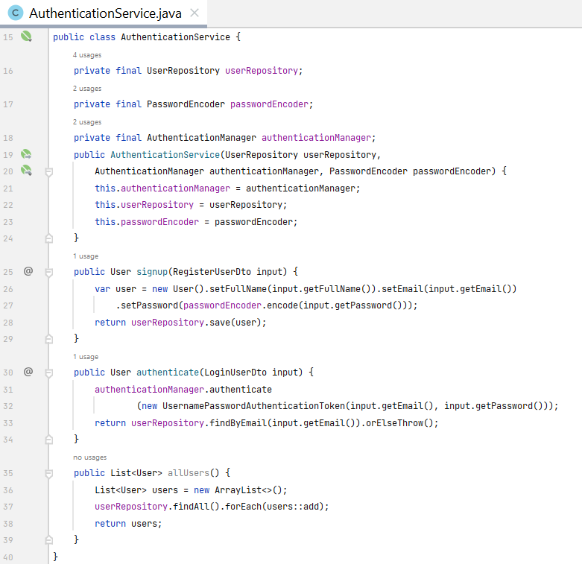
Step 3. (contd.)
Create the authentication service
signup()
authenticate()

Slide 36
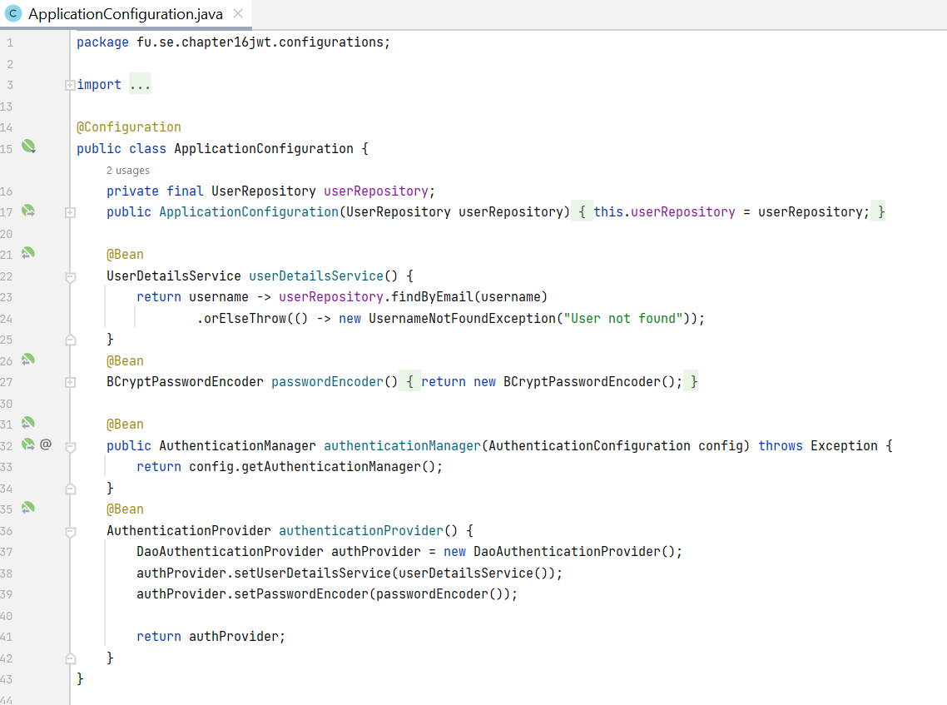
Step 3. (contd.)

Slide 37
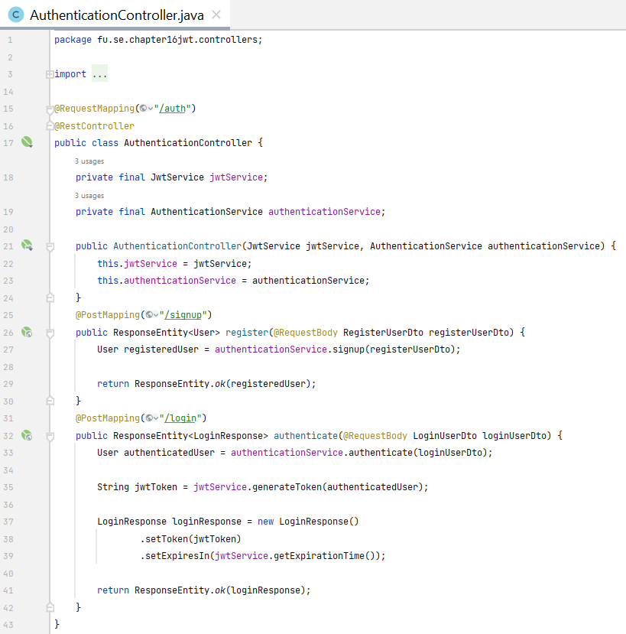
Step 4. Create an authentication controller
Handle login requests.
Authenticate the user.
Generate JWT and send it in the response.

Slide 38
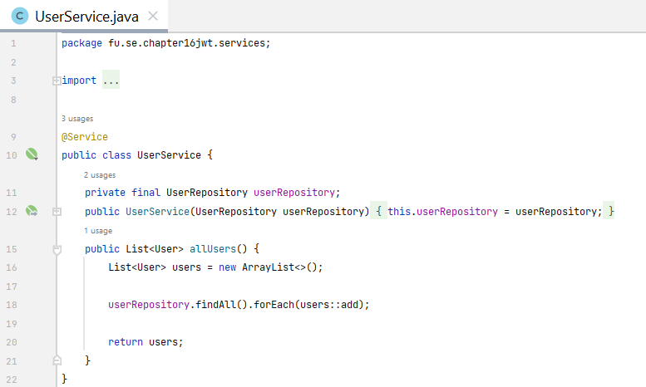
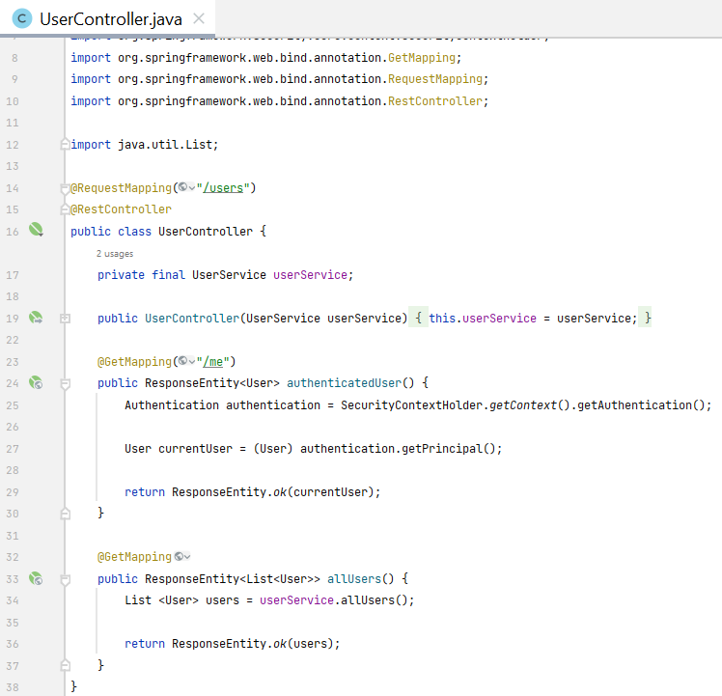
Step 5. Secure endpoints

Slide 39
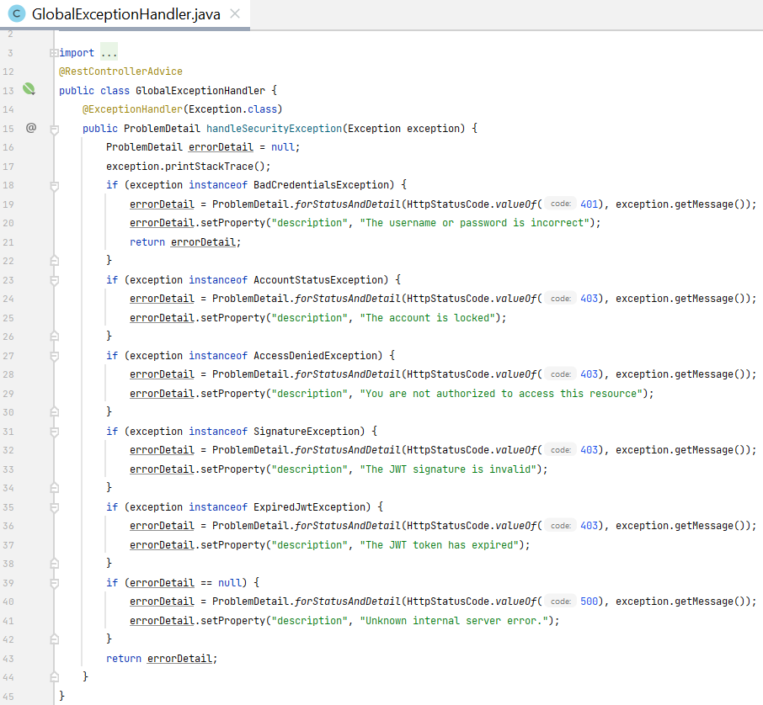
Step 5. (contd.)
Customize authentication error messages

Slide 40
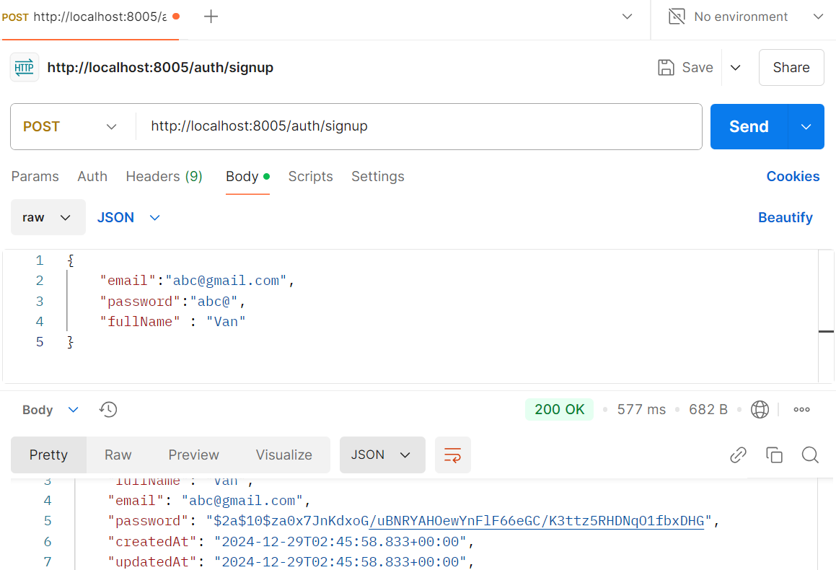
Step 6. Test the implementation
POST request /auth/signup
POST request /auth/login
GET request /users/me
GET request /users

Slide 41
Summary
Concepts were introduced:
Session-based security
HTTP Basic authentication
Digest authentication
Certificate-based security
XAuth
OAuth
JWT Implementation in Spring REST

